Slide 1
Single-neuron representations of odours in the human brain
Kehl et al. 2024
Nature Vol. 634

Slide 2
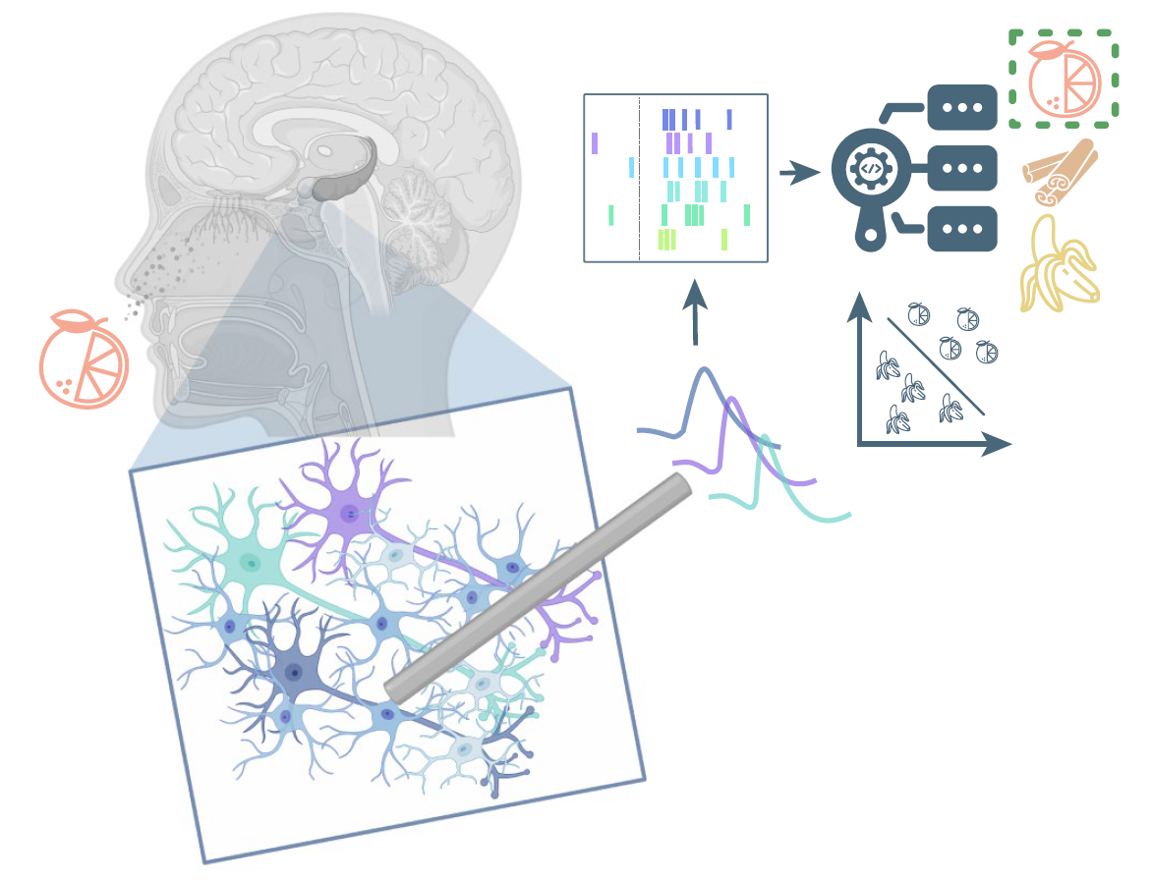
Study
Electrophysiology in awake humans.
Epilepsy patients
Department of Epileptology at the University of Bonn Medical Center
n = 17 (12f, 22-60yrs)

Slide 3
Study
27 sessions
2,416 units
Notes:
1,292 single units

Slide 4
Abstract
Observed odor-modulated neurons in
Piriform cortex
Amygdala
Entorhinal cortex
Hippocampus

Slide 5
Abstract
Observed neurons that respond to semantically-coherent odor and image information.

Slide 6
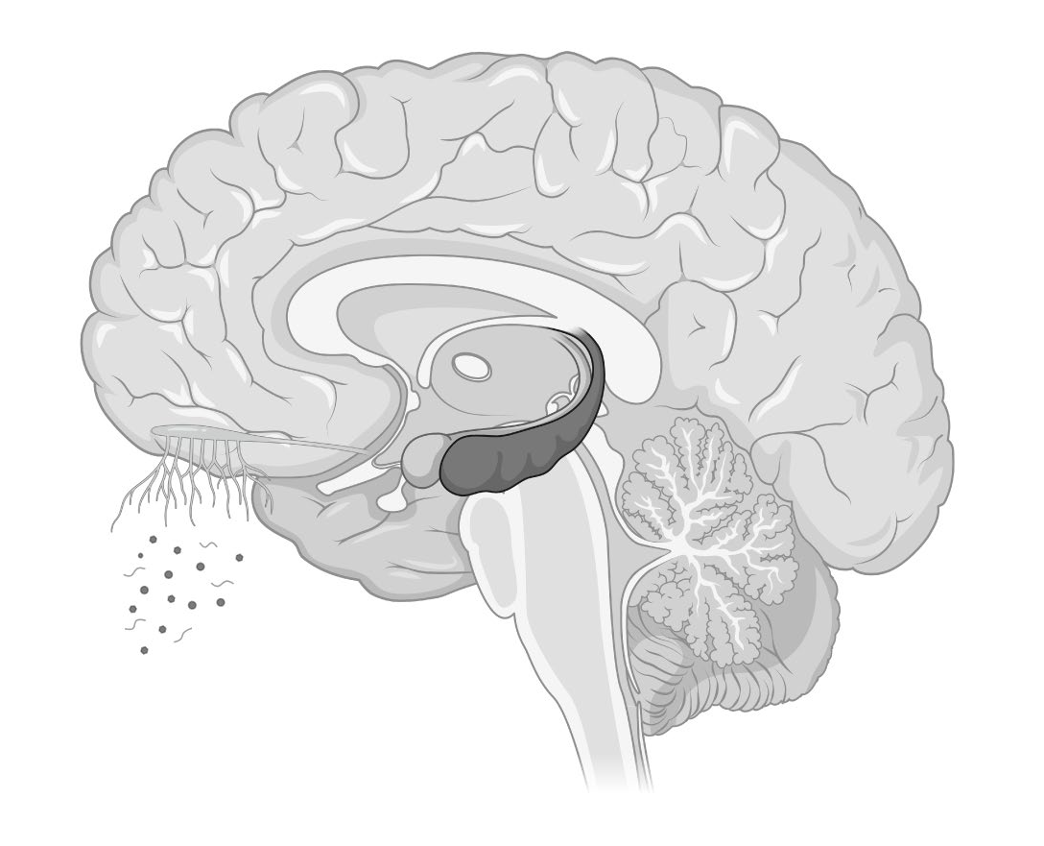
Olfactory Network
Smell
Taste
Navigation

Slide 7
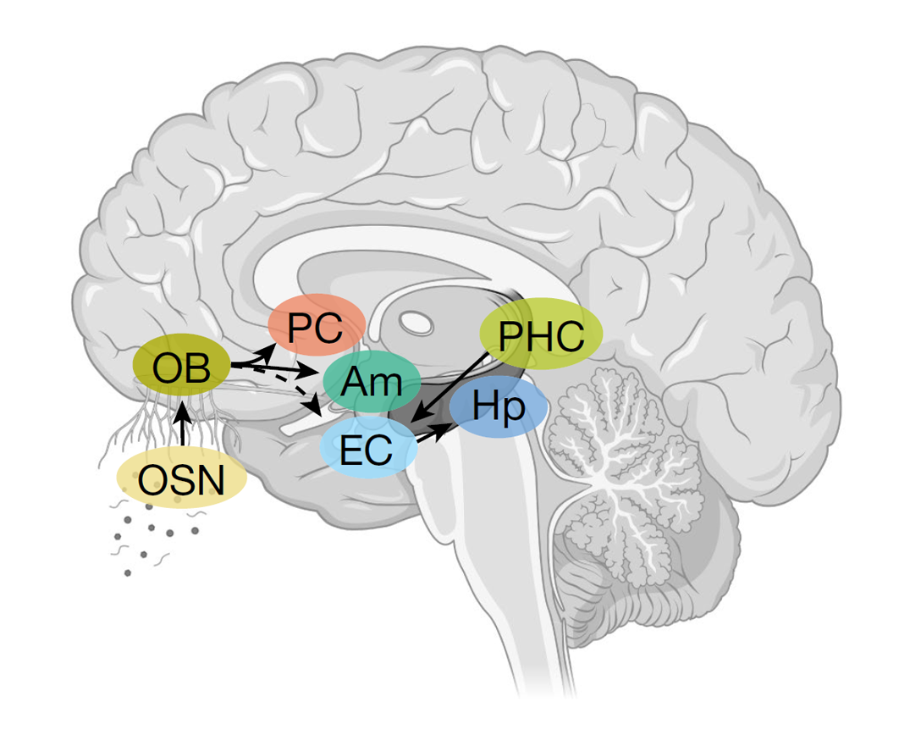
Olfactory Network
Odor Sensory Neurons (OSN)
Olfactory Bulb (OB)
Piriform Cortex (PC)
Amygdala (Am)
Entorhinal Cortex (EC)
Hippocampus (Hp)
Parahippocampal Cortex (PHC)

Slide 8
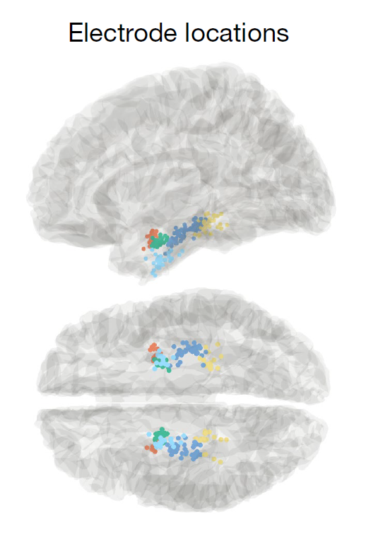
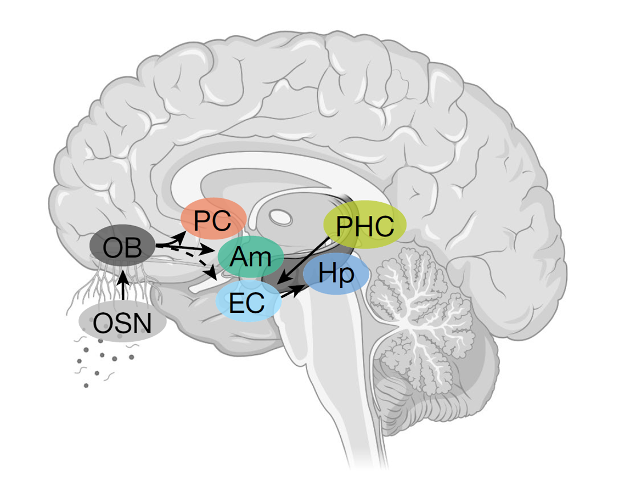
Notes:
All patients had probes in MTL, 9 also had probes in piriform cortex

Slide 9
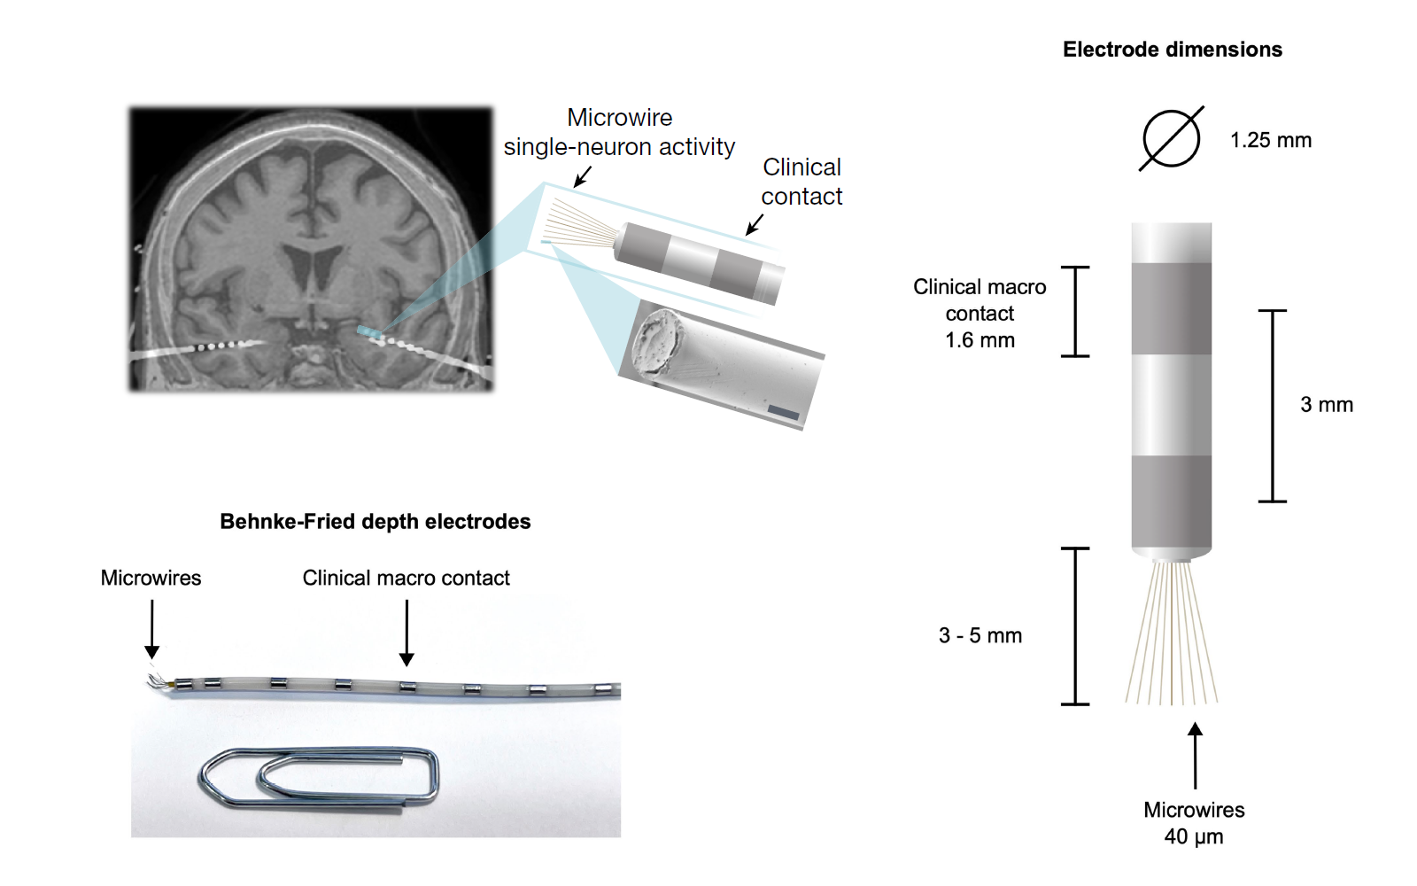
Notes:
Local field potentials containing single-neuron activity were
sampled at 32,768 Hz, band-pass filtered between 0.1 and 9,000 Hz, and
amplified by a 256-channel ATLAS amplifier (Neuralynx) using Pegasus
(v.2.1.1, Neuralynx). Spike extraction and sorting were performed using
Combinato63

Slide 10
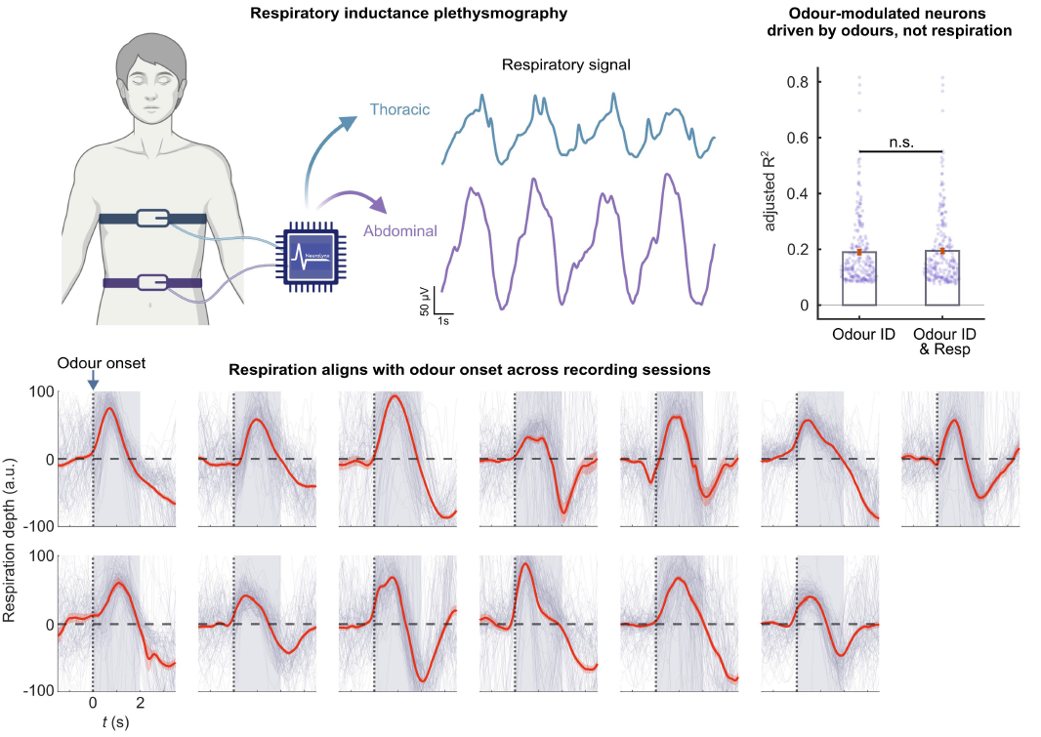
Notes:
b, Performance (adjusted R2) of linear regression models, predicting neuronal
firing (z-scores) based on odour identity, or odour identity combined with
respiration (inhalation depth). Adding respiratory information to odour identity
did not significantly improve the model predictions of firing rates of odourmodulated
Neurons
c, Averaged odour-locked
respiratory signals for each individual recording session (mean ― s.e.m.,
13 sessions with

Slide 11
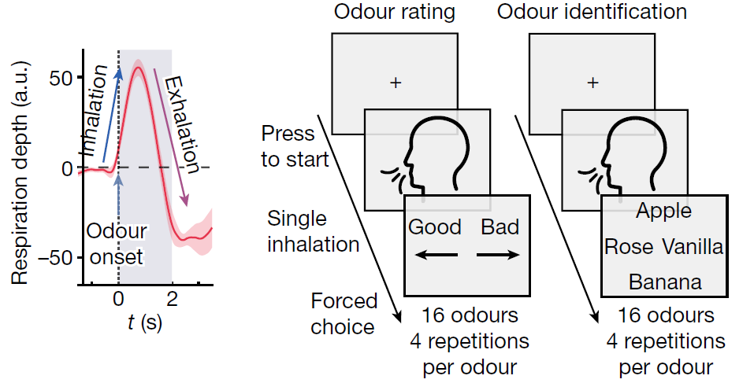
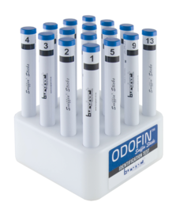
Tasks
Notes:
during the last 4 presentation cycles of each odor (out of 8 total presentations), participants had to identify odors by choosing from 4 written odor name options. These name options were presented sequentially with 1-second intervals between them.
Odour pens were presented approximately 2 cm below the nose, centred between both nostrils.
The patients were verbally instructed on each trial to inhale on command (“Please inhale NOW!”).
The participants identified the correct odour in 74.1 ― 1.5% of cases.
The mean presentation time of odours was 2.31 ― 0.13 s,
the mean inter-odour interval was 19.4s, with the same odors being presented on average 5.2 minutes apart.

Slide 12
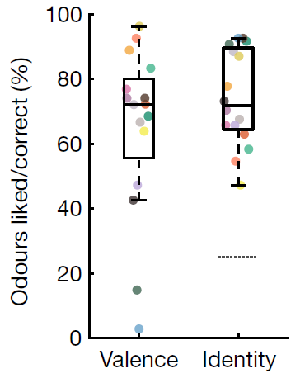
Tasks
Notes:
The behavioural
performance per odour, showing ratings (left) and correct identification (right).
n = 27 sessions. The box plots show the median values (centre lines), 25th–75th
percentiles (box limits), and the whiskers span data within 1.5× the interquartile
range. Statistical analysis of odour identification was performed using twosided
Wilcoxon signed-rank tests versus chance (25%; dashed line);

Slide 13
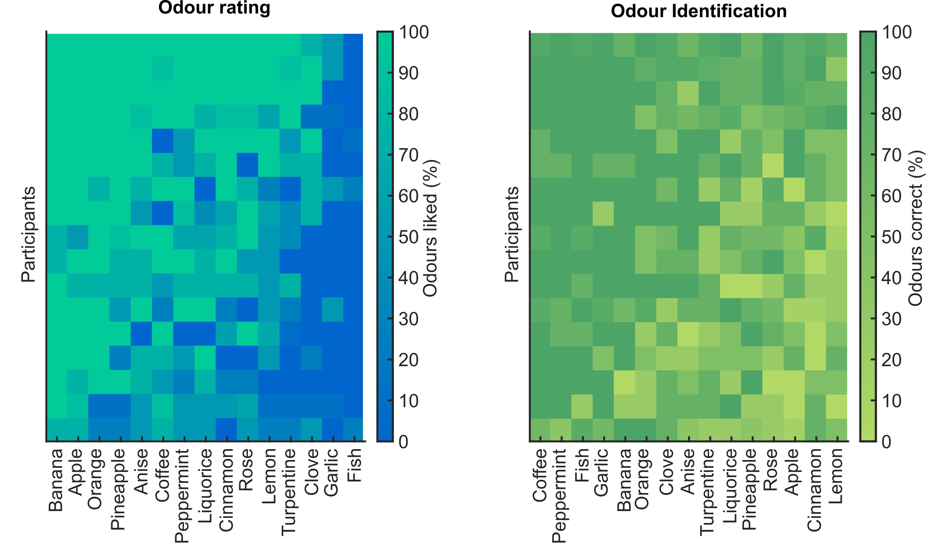
Behavioral Results

Slide 14
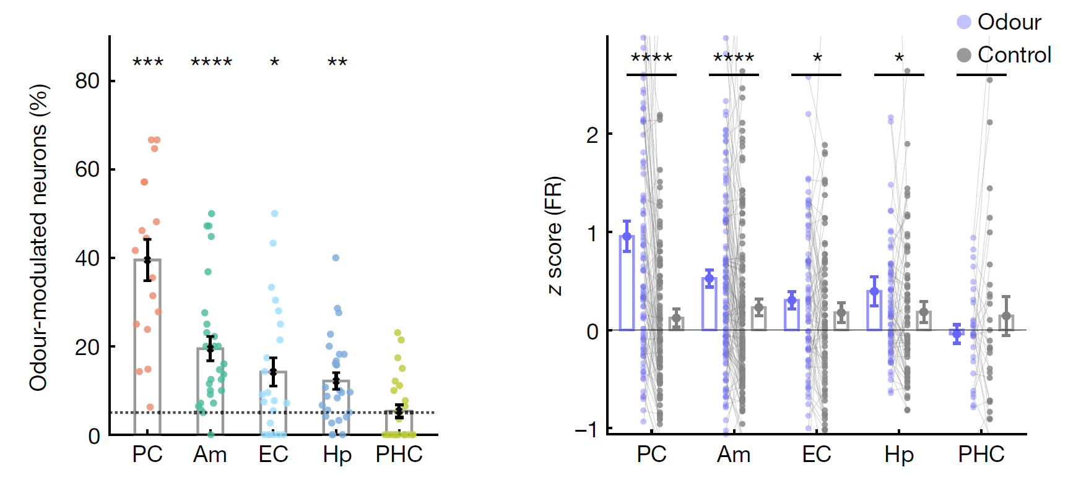
Odors modulate PC and MTL firing
Notes:
Odour-modulated
neurons per session and region (mean ― s.e.m.). The PC, amygdala, EC and
hippocampus host significant populations of odour-modulated neurons

Slide 15
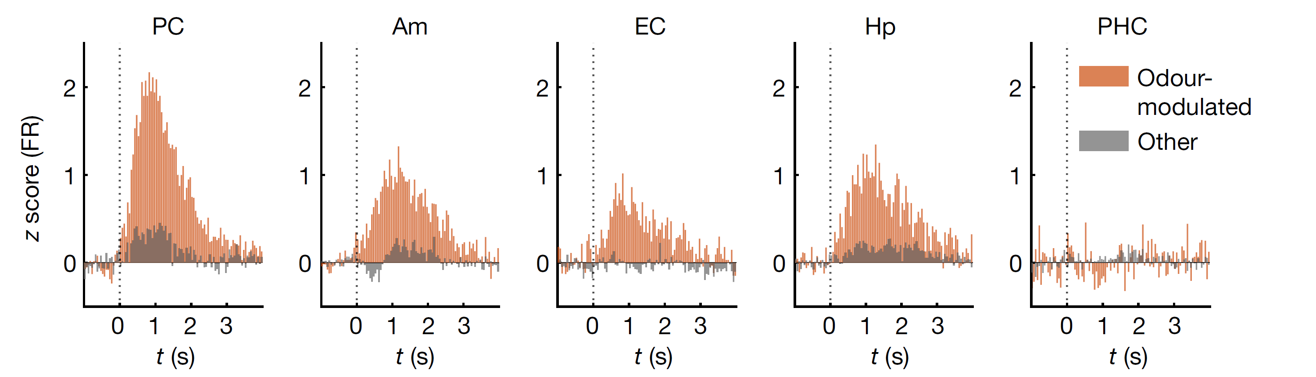
Odors modulate PC and MTL firing
Notes:
To identify odour-modulated neurons, we first calculated a z value
for the firing rate during a response interval ([0, 2 s] after odour onset
compared to [−5, 0 s] before odour onset) and performed a one-way
ANOVA for odour identity. Neurons with a significant effect of odour
identity across all 128 trials (P < 0.05) were termed odour-modulated
neurons

Slide 16
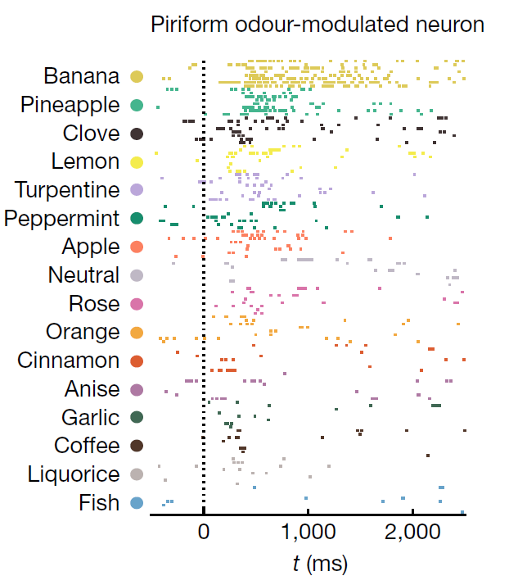

Neuronal activity encodes odor identity

Slide 17
Decoding odor identity from neural data

Slide 18
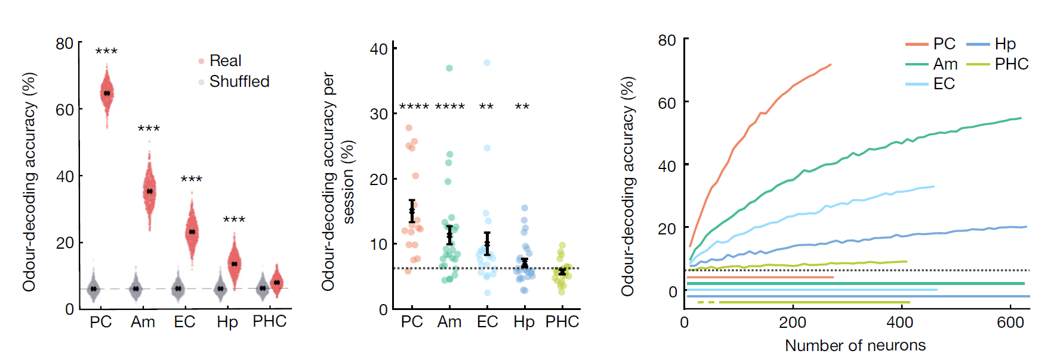
Decoding odor identity from neural data
Notes:
b, The odour-identity decoding accuracy per region. Each red
dot shows the decoding performance based on 200 randomly drawn neurons
(1,000 subsampling runs).
The decoding performance (mean ― s.e.m.) across
subsampling runs is shown in black. The grey dots indicate the decoding
performance on label-permuted data.
e, The odour decoding performance (mean ― s.e.m., black) per recording
session and region (coloured dots). Despite the limited and variable neuron
counts per session, odour identity could be decoded significantly above
chance (6.25%, dashed line) in the PC, amygdala, EC and hippocampus

Slide 19
Decoding odor identity from neural data
Piriform cortex is especially accurate.
Notes:
Next we’ll look at what other regions are specialized in.

Slide 20
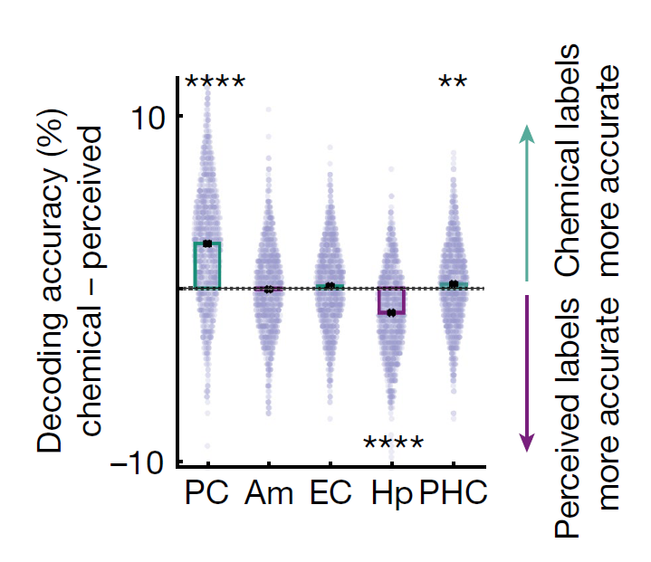
Notes:
Hp predicted behavioral odor identification performance.
Other regions did not.

Slide 21
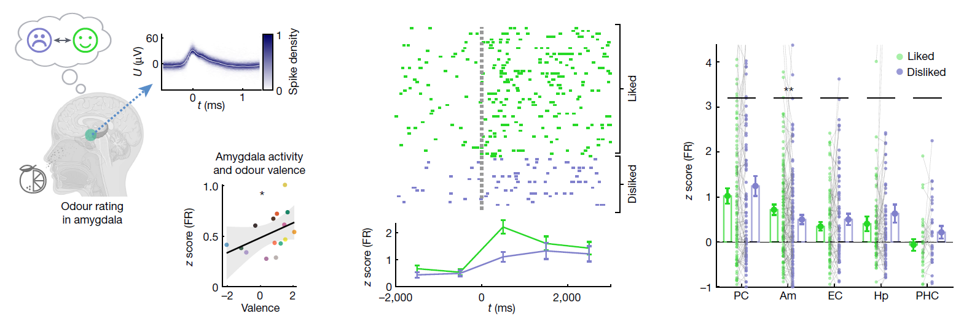
Amygdala predicts valenced responses
Single amygdala neuron
Notes:
Hp predicted behavioral odor identification performance.
Other regions did not.

Slide 22
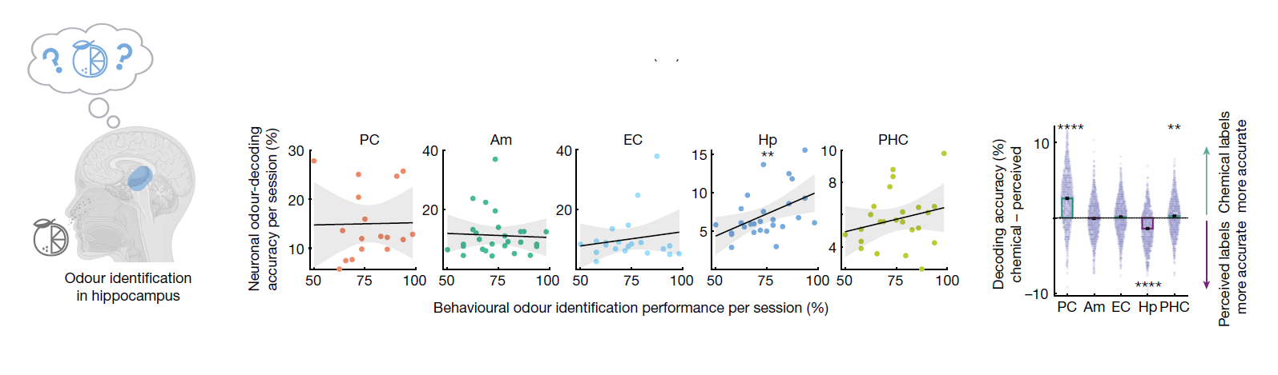
Hippocampus predicts perceptual choice
Notes:
Hp predicted behavioral odor identification performance.
Other regions did not.

Slide 23
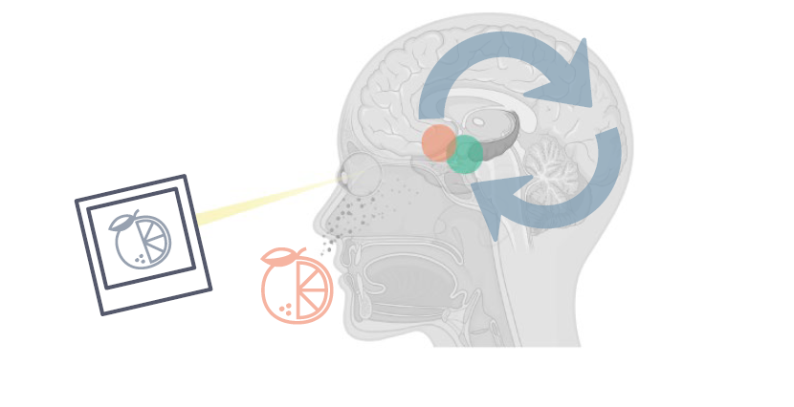
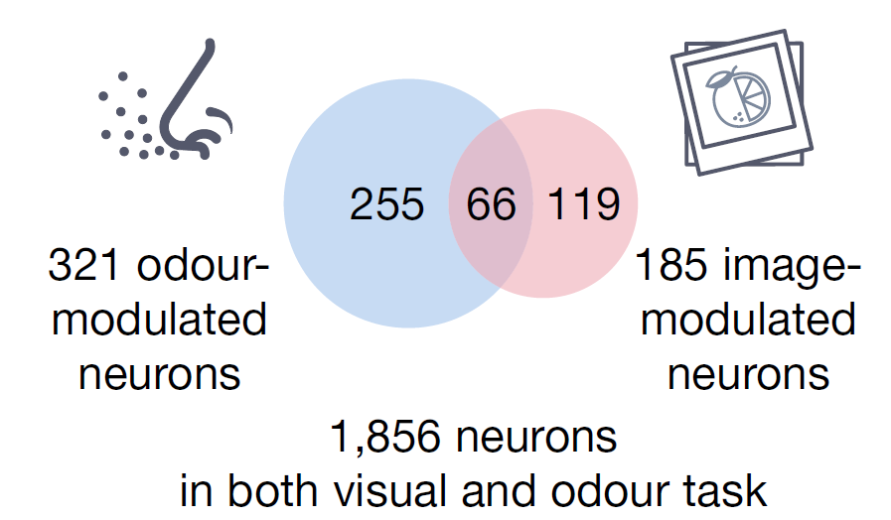
Multimodal odor-modulated cells
In 20 of 27 sessions, semantically-matched visual stimuli were presented in a block following the odor task.
Notes:
"In 20 out of 27 recordings, immediately after the olfactory task, we additionally presented 16 pictures, each semantically corresponding to one of the odours, including a light grey screen to match the odourless control. Each picture was presented for 1 s, 8 times, in pseudorandom order

Slide 24
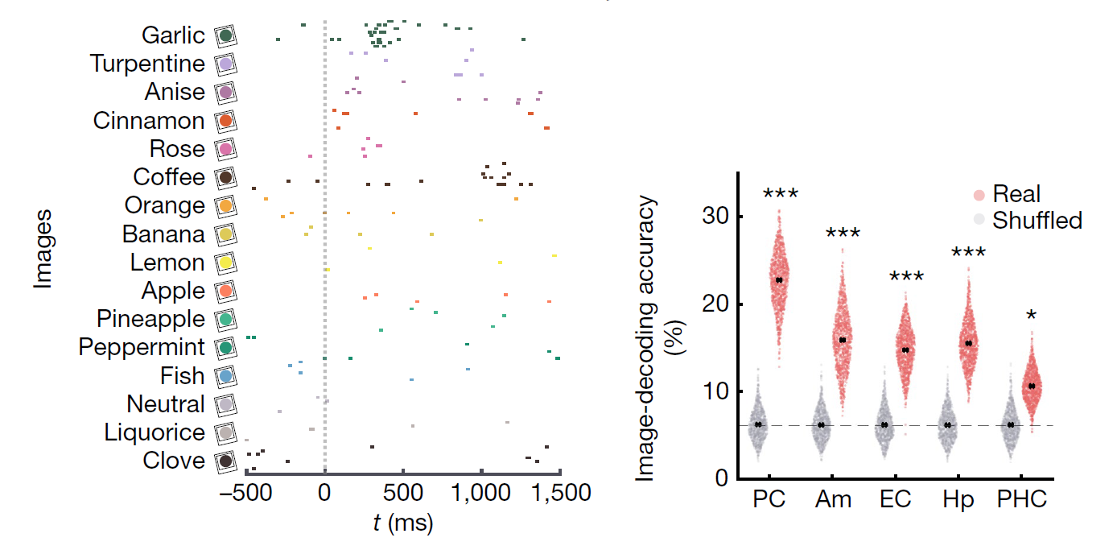
Image-modulated cells
Notes:
"In 20 out of 27 recordings, immediately after the olfactory task, we additionally presented 16 pictures, each semantically corresponding to one of the odours, including a light grey screen to match the odourless control. Each picture was presented for 1 s, 8 times, in pseudorandom order

Slide 25
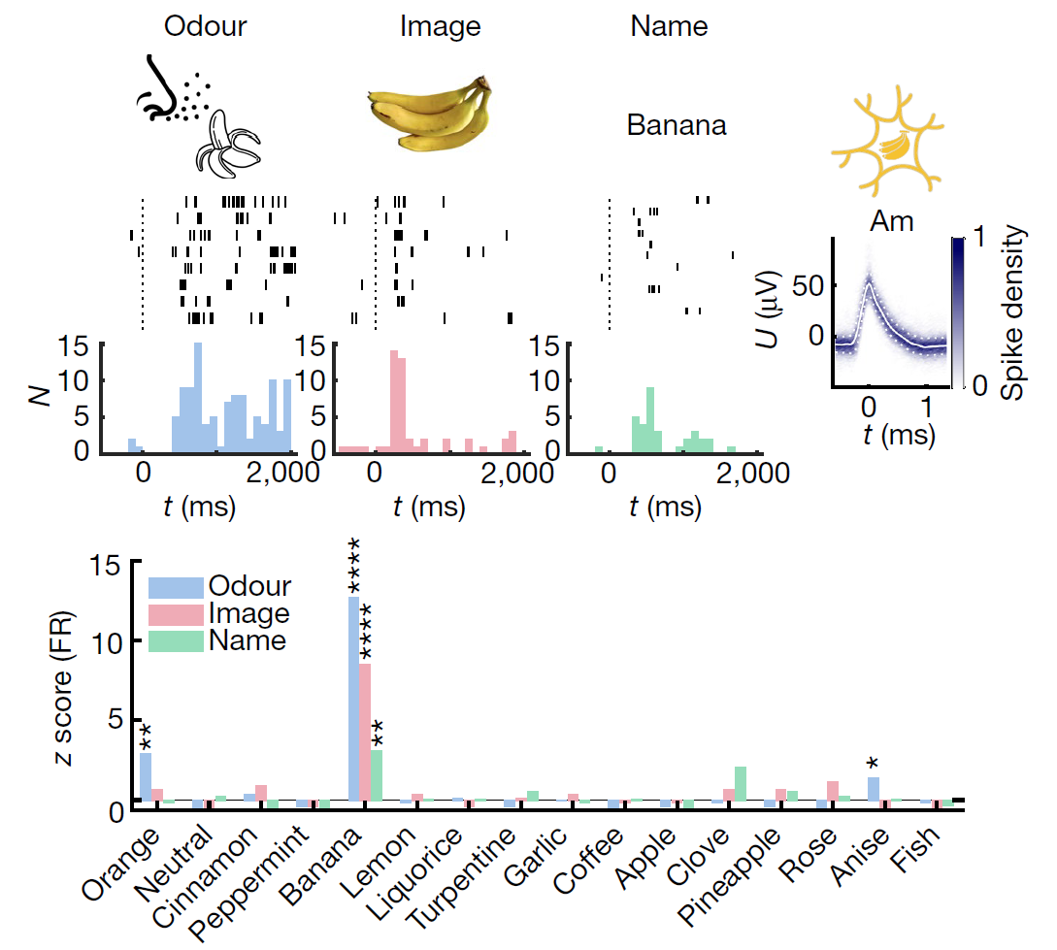
Multimodal Banana Cell (Am)
Notes:
Middle row is spike count histograms showing the number of spikes per 100ms time bin
Bottom row is z-scored firing rate in the 2s post-stimulus, versus the firing rate 2s pre-stimulus.

Slide 26
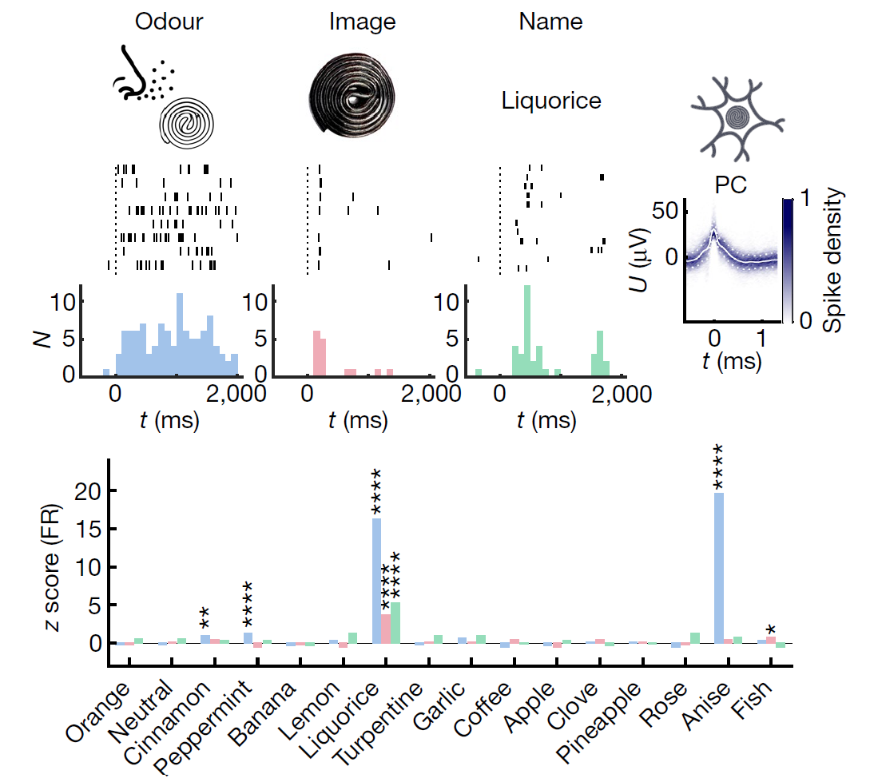
Multimodal Licorice Cell (PC)

Slide 27
Summary
Different regions in the olfactory network represent distinct aspects of the olfactory percept.

Slide 28
Summary
Everything does everything, but in general:
PC encodes chemical identity
Amygdala encodes odor valence
Hippocampus encodes subjective perception

Slide 29
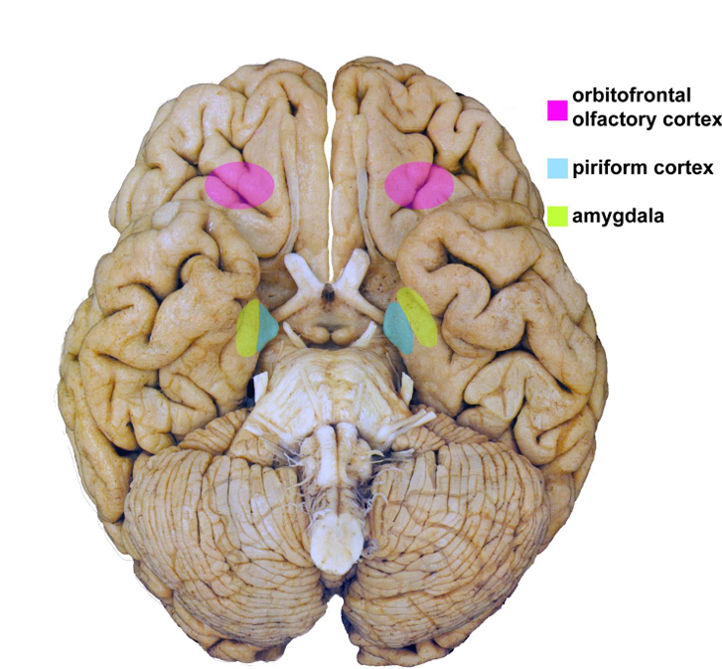

Slide 30
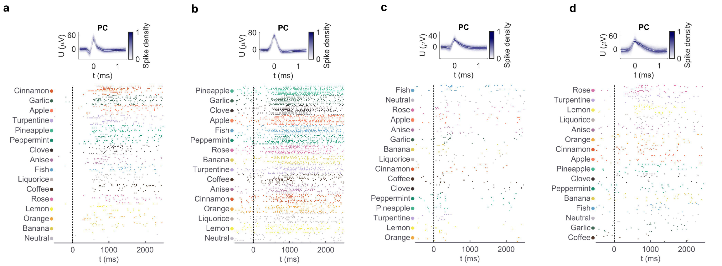

Slide 31
